Slide 1
BUYING A HOME
THINGS TO CONSIDER WHEN
SPRING 2021
EDITION

Slide 2
TABLE OF CONTENTS
3
5
6
7
9
11
12
13
14
16
17
19
Buying a Home This Spring
Expert Insights for This Spring’s Homebuyers
Staying Patient in a Competitive Market
3 Reasons We’re Not in a Housing Bubble
Why the Cost of a Home Is More Critical Than the Price
Owning a Home Is Still More Affordable Than Renting One
Key Terms to Know in the Homebuying Process
The Path to Homeownership
Do I Really Need a 20% Down Payment?
Things to Avoid after Applying for a Mortgage
5 Tips for Making a Successful Offer
Reasons to Hire a Real Estate Professional
2

Slide 3
Buying a Home This Spring
The housing market recovery has been nothing short of remarkable. Many experts agree the turnaround from the nation’s economic pause last year is playing out extremely well for real estate, so it’s an ideal time to buy a home for those who are ready to make a purchase. Here’s a dive into some of the biggest wins for homebuyers this spring.
1. Mortgage Rates Are Still Low
In 2020, mortgage rates hit all-time lows 16 times, falling below 3% for the first time ever. Continued low rates in the early part of this year are setting buyers up for significant long-term gains. According to Freddie Mac:
“Optimism continues as the economy slowly regains its footing, thus affecting mortgage rates. Though rates continue to rise, they remain near historic lows.”
Essentially, it’s less expensive to borrow money for a home loan today while rates are low. This is a huge opportunity for buyers to capitalize on right now.
2. Buying Is More Affordable Than Renting
This trend of low mortgage rates has made the typical monthly payment (including principal and interest) less expensive for buyers. According to Odeta Kushi, Deputy Chief Economist for First American:
“The low mortgage rates and income growth spurred an 18.9 percent increase in house-buying power compared with a year ago.”
Buying a home now versus renting one may be a game-changer as it amplifies long-term savings for homeowners. When paying a mortgage as opposed to paying rent, that money is reinvested back in your favor, so you’re contributing to your own net worth when you own a home. This is a term called equity, and it’s one of the biggest financial benefits of homeownership.
3
Notes:
http://www.freddiemac.com/pmms/pmms_archives.html
https://freddiemac.gcs-web.com/node/22196/pdf
https://blog.firstam.com/economics/housing-market-potential-poised-to-grow-in-2021

Slide 4
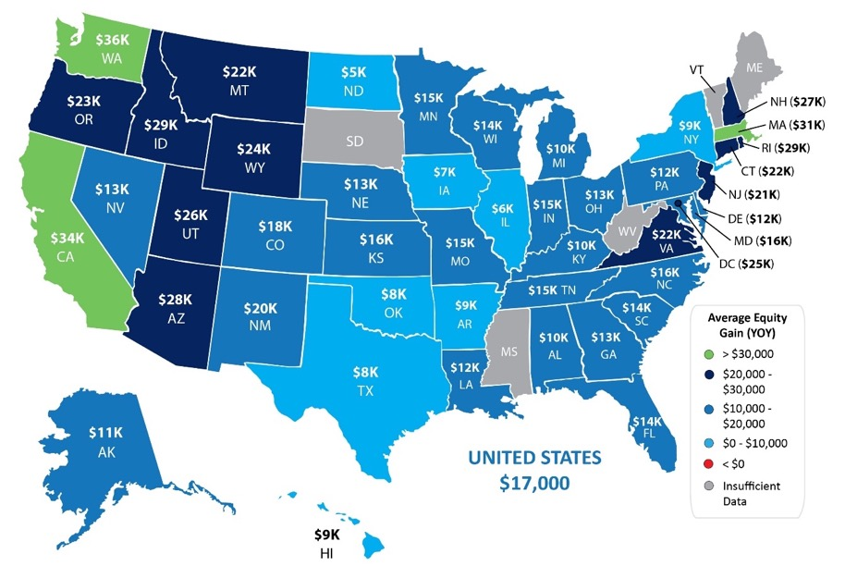
3. Equity Is Growing
The Homeowner Equity Report from CoreLogic notes that the average homeowner gained $17,000 in equity in just the last year. With equity growing so significantly, you can feel confident that homeownership is a sound investment in your future.
4. Home Prices Are Appreciating
According to many leading experts, home prices are forecasted to continue appreciating this year. When home values appreciate, it’s another factor that increases your equity. According to Lawrence Yun, Chief Economist for the National Association of Realtors (NAR):
“The housing market was a spectacular surprise in 2020—and the positive trend will continue this year. Home sales in 2021 are expected to rise by around 10%. Home prices will also climb, but I expect more moderate increases than we’ve seen, a break for first-time buyers. Mortgage rates will continue to be favorable, staying at or near historic lows of 3% on average. The labor market will strengthen, especially as vaccines become widely available and life moves toward normal.”
Knowing home values are increasing while mortgage rates are so low should help you feel confident that buying a home this year is advantageous from a price perspective and a strong long-term investment.
Bottom Line
If you’re considering buying a home, this may be your moment, especially with today’s low mortgage rates. Let’s connect to assess your changing needs and set you up for success in the homebuying process.
Homeowner Equity Gains over the Last Year
4
Notes:
https://www.corelogic.com/insights/homeowner-equity-report.aspx
https://magazine.realtor/news-and-commentary/economy/article/2021/01/real-estate-in-2021-plenty-of-reason-for-optimism

Slide 5
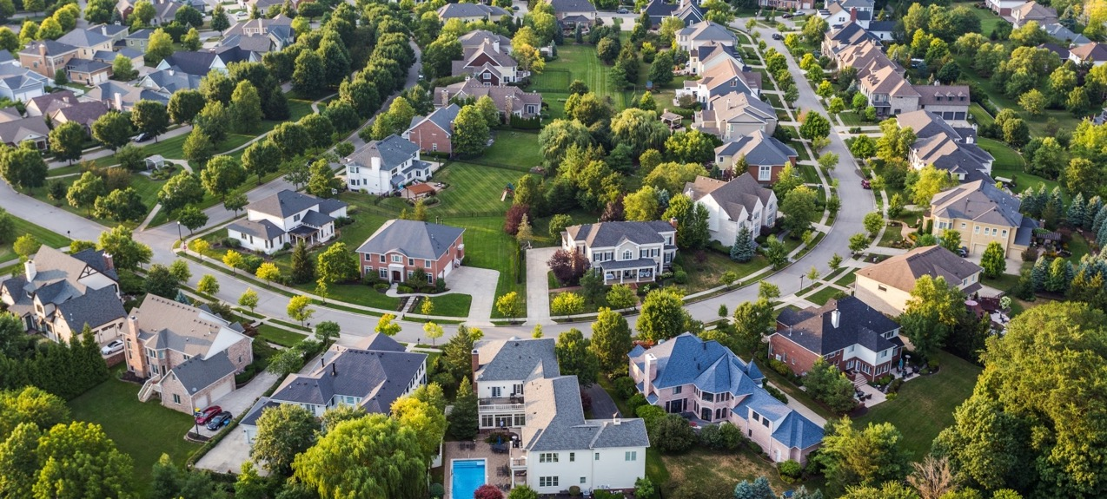
Expert Insights for This Spring’s Homebuyers
Here’s a look at what several industry leaders have to say about how homebuyers may be empowered in the housing market this spring and into next year.
Ali Wolf, Chief Economist, Zonda:
“Some people will feel comfortable listing their home during the first half of 2021. Others will want to wait until the vaccines are widely distributed. This suggests more inventory will be for sale in late 2021 and into the spring selling season in 2022.”
Freddie Mac:
“The average 30-year fixed-rate mortgage hit a record low over a dozen times in 2020 and the low interest rate environment is projected to continue through this year. We expect interest rates to average below 3% through the end of 2021.”
Nicolas Bedo, Economic Data Analyst, realtor.com:
“Nationally, the median listing price for a home is $340,000. With a median 1-bedroom rent of $1,533, it would take 11 months to save for the 5 percent down payment of $17,000.
No matter their location, young people who are able to remain gainfully employed and cut back on housing costs because they move back with family to ride out the pandemic will be able to amass significant savings and likely become homeowners sooner than otherwise expected.”
Bottom Line
The experts are very optimistic about the housing market right now. If you pressed pause on your real estate plans last year, let’s chat to determine how you can re-engage in the homebuying process this spring.
5
Notes:
https://www.realtor.com/news/trends/vaccines-housing-market/
http://www.freddiemac.com/blog/research_and_analysis/20210125_what_will_2021_bring_for_housing.page
https://www.realtor.com/research/down-payment-savings-2021/
https://money.com/housing-shortage-supply-forecasts/
https://www-housingwire-com.cdn.ampproject.org/c/s/www.housingwire.com/articles/mba-forecast-for-2021-prepare-for-rising-mortgage-interest-rates/amp/
https://www.nar.realtor/newsroom/pending-home-sales-falter-2-2-in-September

Slide 6
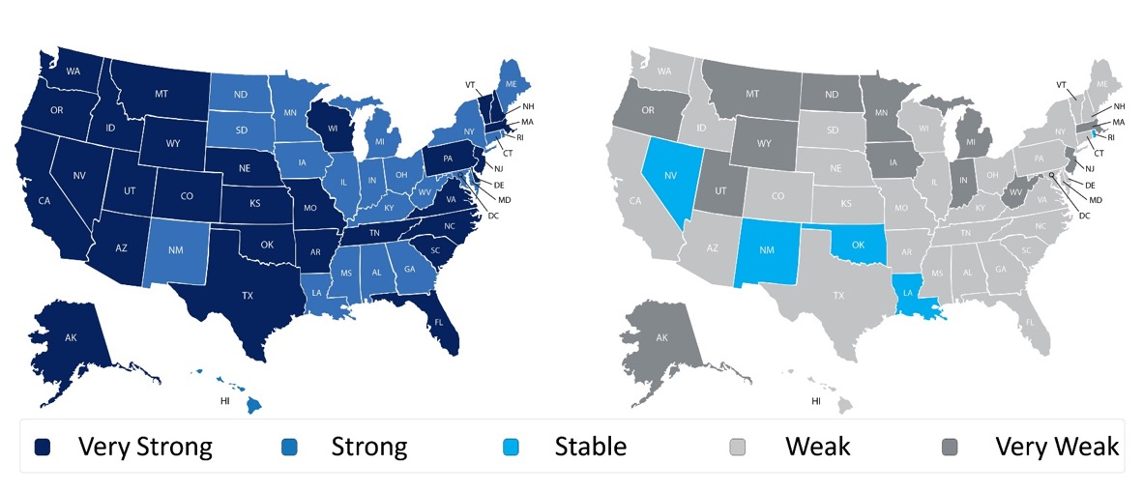
Staying Patient in a Competitive Market
According to the Realtors Confidence Index Survey from the National Association of Realtors (NAR), buyer demand across the country is incredibly strong. That’s not the case, however, on the supply side. Seller traffic is simply not keeping up, making it challenging in many areas for buyers to find homes to purchase. Here’s a breakdown by state:
Buyer Traffic Index
Seller Traffic Index
NAR also reports that the actual number of homes for sale stands at 1.04 million units, down 25.7% from one year ago (1.40 million). Inventory is at an all-time low with 1.9 months’ supply available at the current sales pace. In a normal market, that number would be 6.0 months of inventory – significantly higher than it is today.
What does this mean for you?
If you’re ready to buy and you’re having trouble finding a home, remain patient in the search process. At the same time, be ready to act immediately once you find the right home since bidding wars are more common when so few houses are up for sale.
Bottom Line
Let’s connect so you have an expert guide to help you balance both patience and persistence in the homebuying process.
6
Notes:
https://www.nar.realtor/research-and-statistics/research-reports/realtors-confidence-index
https://www.nar.realtor/research-and-statistics/housing-statistics/existing-home-sales

Slide 7
3 Reasons We’re Not in a Housing Bubble
Home values appreciated by almost ten percent in 2020, and they’re forecast to continue rising this year. This has some voicing concern that we may be in another housing bubble like the one we experienced a little over a decade ago. Here are three reasons why that’s actually not the case and the market is completely different today.
1. This time, housing supply is extremely limited.
The price of any item is determined by supply and demand. If supply is high and demand is low, prices normally decrease. If supply is low and demand is high, prices naturally increase.
In real estate, this balance is measured in “months’ supply of inventory” which is based on the number of current homes for sale compared to the number of buyers in the market. The normal months’ supply of inventory for the market is about 6 months. Anything above that defines a buyers’ market, indicating prices will soften. Anything below that defines a sellers’ market in which prices normally appreciate.
Between 2006 and 2008, the months’ supply of inventory increased from just over 5 months to 11 months. The months’ supply was over 7 months in twenty-seven of those thirty-six months, yet home values continued to rise. Months’ inventory has been under 5 months for the last 3 years, under 4 for thirteen of the last fourteen months, and under 3 for the last six months. It currently stands at 1.9 months – a historic low. Remember, if supply is low and demand is high, prices naturally increase.
2. This time, housing demand is real.
During the housing boom in the mid-2000s, there was what Robert Schiller, a fellow at the Yale School of Management's International Center for Finance, called “irrational exuberance.” The definition of the term is, “unfounded market optimism that lacks a real foundation of fundamental valuation, but instead rests on psychological factors.” Without considering historic market trends, people got caught up in the frenzy and bought houses based on an unrealistic belief that housing values would continue to escalate.
The mortgage industry fed into this craziness by making mortgage money available to just about anyone, as shown in the Mortgage Credit Availability Index (MCAI) published by the Mortgage Bankers Association. The higher the index, the easier it is to get a mortgage; the lower the index, the more difficult it is to obtain one. Prior to the housing boom, the index stood just below 400. In 2006, the index hit an all-time high of over 868, meaning just about anyone could qualify for a mortgage. Today, the index stands at 124.6, which is well below even the pre-boom level.
7
Notes:
https://www.investopedia.com/terms/i/irrationalexuberance.asp#:~:text=Irrational%20exuberance%20is%20unfounded%20market,bubble%20in%20the%20stock%20market.
https://www.mba.org/news-research-and-resources/research-and-economics/single-family-research/mortgage-credit-availability-index

Slide 8
In the current real estate market, demand is real, not fabricated. Millennials, the largest generation in the country, have come of age to marry and have children, which are two major drivers for homeownership. The health crisis is also challenging every household to redefine the meaning of “home” and re-evaluate whether their current home meets that new definition. This desire to own, coupled with historically low mortgage rates, makes purchasing a home today a strong, sound financial decision. Therefore, today’s demand is very real. Remember, if supply is low and demand is high, prices naturally increase.
3. This time, households have plenty of equity.
Again, during the housing boom, it wasn’t just purchasers who got caught up in the frenzy. Existing homeowners started using their homes like ATM machines. There was a wave of cash-out refinances, which enabled homeowners to leverage the equity in their homes. From 2005 through 2007, Americans pulled out $824 billion dollars in equity. That left many homeowners with little or no equity in their homes at a critical time. As prices began to drop, some homeowners found themselves in a negative equity situation where the mortgage was higher than the value of their home. Many defaulted on their payments, which led to an avalanche of foreclosures.
Today, the banks and the American people have shown they learned a valuable lesson from the housing crisis a little over a decade ago. Cash-out refinance volume over the last three years was less than a third of what it was compared to the 3 years leading up to the crash.
This approach has created levels of equity never seen before. According to Census Bureau data, over 38% of owner-occupied housing units are owned ‘free and clear’ (without any mortgage). Also, ATTOM Data Solutions just released their fourth quarter 2020 U.S. Home Equity Report, which reveals:
“17.8 million residential properties in the United States were considered equity-rich, meaning that the combined estimated amount of loans secured by those properties was 50 percent or less of their estimated market value…The count of equity-rich properties in the fourth quarter of 2020 represented 30.2 percent, or about one in three, of the 59 million mortgaged homes in the United States.”
If we combine the 38% of homes that are owned free and clear with the 18.7% of all homes that have at least 50% equity (30.2% of the remaining 62% with a mortgage), we realize that 56.7% of all homes in this country have a minimum of 50% equity. That’s significantly better than the equity situation in 2008.
Bottom Line
This time, housing supply is at a historic low. Demand is real and rightly motivated. Even if prices were to drop, homeowners have enough equity to be able to weather a dip in home values. This is nothing like 2008. In fact, it’s the exact opposite.
8
Notes:
http://www.freddiemac.com/research/datasets/refinance-stats/index.page
https://constructioncoverage.com/research/where-residents-have-paid-off-homes
https://www.attomdata.com/news/market-trends/home-sales-prices/attom-data-solutions-q4-2020-u-s-home-equity-underwater-report/

Slide 9
Why the Cost of a Home Is More Critical
Than the Price
Housing inventory is at an all-time low. There are 25.7% fewer homes for sale today than there were this time last year, and buyer demand is very strong. The Pending Home Sales Index (PHSI) by the National Association of Realtors (NAR) reports:
“Year-over-year, contract signings rose 13.0%.”
As we’ve established, whenever there's a shortage in supply of an item that’s in high demand, the price of that item increases. That’s exactly what’s happening in the real estate market right now. The Home Price Index from CoreLogic reports that home prices increased by 10% over the past year. CoreLogic also forecasts a 3.3% home price increase on a year-over-year basis by the end of 2021, and that’s on the low end of most expert forecasts, so they may rise even higher.
This is great news if you’re planning to sell your house. On the other hand, as either a first-time or repeat buyer, this may instead seem like troubling news. However, purchasers should realize that the price of a house is not as important as the cost. Let’s break it down.
There are several factors that influence the cost of a home. The two major ones are the price of the home and the interest rate at which a buyer can borrow the funds necessary to purchase the home.
According to Freddie Mac, the average interest rate for a 30-year fixed-rate mortgage in January 2020 was 3.62%. The rate for January 2021 was 2.73%. Let’s use an example to see how that difference impacts the true cost of a home.
Assume you purchased a home in January of 2020 and took out a $350,000 mortgage. To buy that same home in January of 2021, applying last year’s appreciation of 10%, you would have needed to take out a mortgage of $385,000.
9
Notes:
https://www.nar.realtor/research-and-statistics/housing-statistics/pending-home-sales
https://www.corelogic.com/insights-download/home-price-index.aspx
http://www.freddiemac.com/pmms/pmms_archives.html

Slide 10
How will your monthly payment change based on this year’s lower mortgage rates?
This table calculates the difference you would see in your monthly payment at a lower mortgage rate while applying home price appreciation as well:
That’s a savings of almost $28 per month, which equates to $336 annually or $10,080 over the life of the 30-year home loan.
Bottom Line
Even as home values continue to appreciate, it’s a great time to buy a home while mortgage rates are still very low.
Difference in Monthly Payment
Time of Purchase | Mortgage Amount* | Interest Rate** | Monthly Mortgage Payment (Principal & Interest)
2020 | $350,000 | 3.62% | $1,595.19
2021 | $385,000 | 2.73% | $1,567.65
Difference in Payment: |  |  | You Save $27.54
*Using a 10% increase in home values for the past year, per CoreLogic
**Freddie Mac Mortgage rates for January 2020 and 2021
10
Notes:
http://www.freddiemac.com/pmms/pmms_archives.html
https://www.corelogic.com/insights-download/home-price-index.aspx

Slide 11
Owning a Home Is Still More Affordable
Than Renting One
If spending more time at home over the past year is making you think hard about buying instead of renting, you’re not alone. You may, however, be wondering if the dollars and cents add up in your favor as home prices continue to rise. According to the experts, in many cases, it’s still more affordable to buy a home than to rent one. Here’s why.
ATTOM Data Solutions recently released the 2021 Rental Affordability Report, which states:
“Owning a median-priced three-bedroom home is more affordable than renting a three-bedroom property in 572, or 63 percent of the 915 U.S. counties analyzed for the report.
That has happened even though median home prices have increased more than average rents over the past year in 83 percent of those counties and have risen more than wages in almost two-thirds of the nation.”
How is this possible?
The answer: historically-low mortgage interest rates. Todd Teta, Chief Product Officer with ATTOM Data Solutions, explains:
“Home-prices are rising faster than rents and wages in the majority of the country. Yet, home ownership is still more affordable, as amazingly low mortgage rates that dropped below 3 percent are helping to keep the cost of rising home prices in check.”
These low rates are a big factor in driving affordability. Teta also notes:
“But it shows how both the cost of renting has been relatively high compared to the cost of ownership and how declining interest rates are having a notable impact on the housing market and home ownership. The coming year is totally uncertain, amid so many questions connected to the Coronavirus pandemic and the broader economy. But right now, owning a home still appears to be a financially-sound choice for those who can afford it.”
Bottom Line
If you’re considering buying a home this year, let’s connect today to discuss the options that match your budget while affordability is in your favor.
11
Notes:
https://www.attomdata.com/news/market-trends/home-sales-prices/attom-data-solutions-2021-rental-affordability-report/

Slide 12
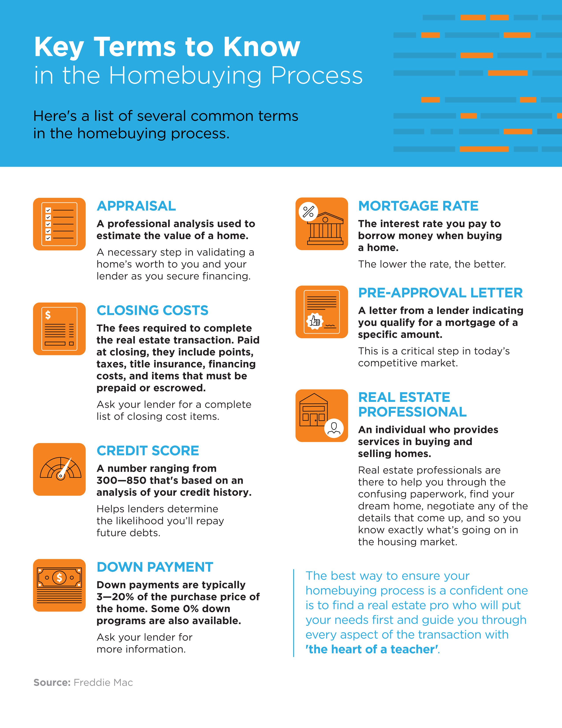
12

Slide 13
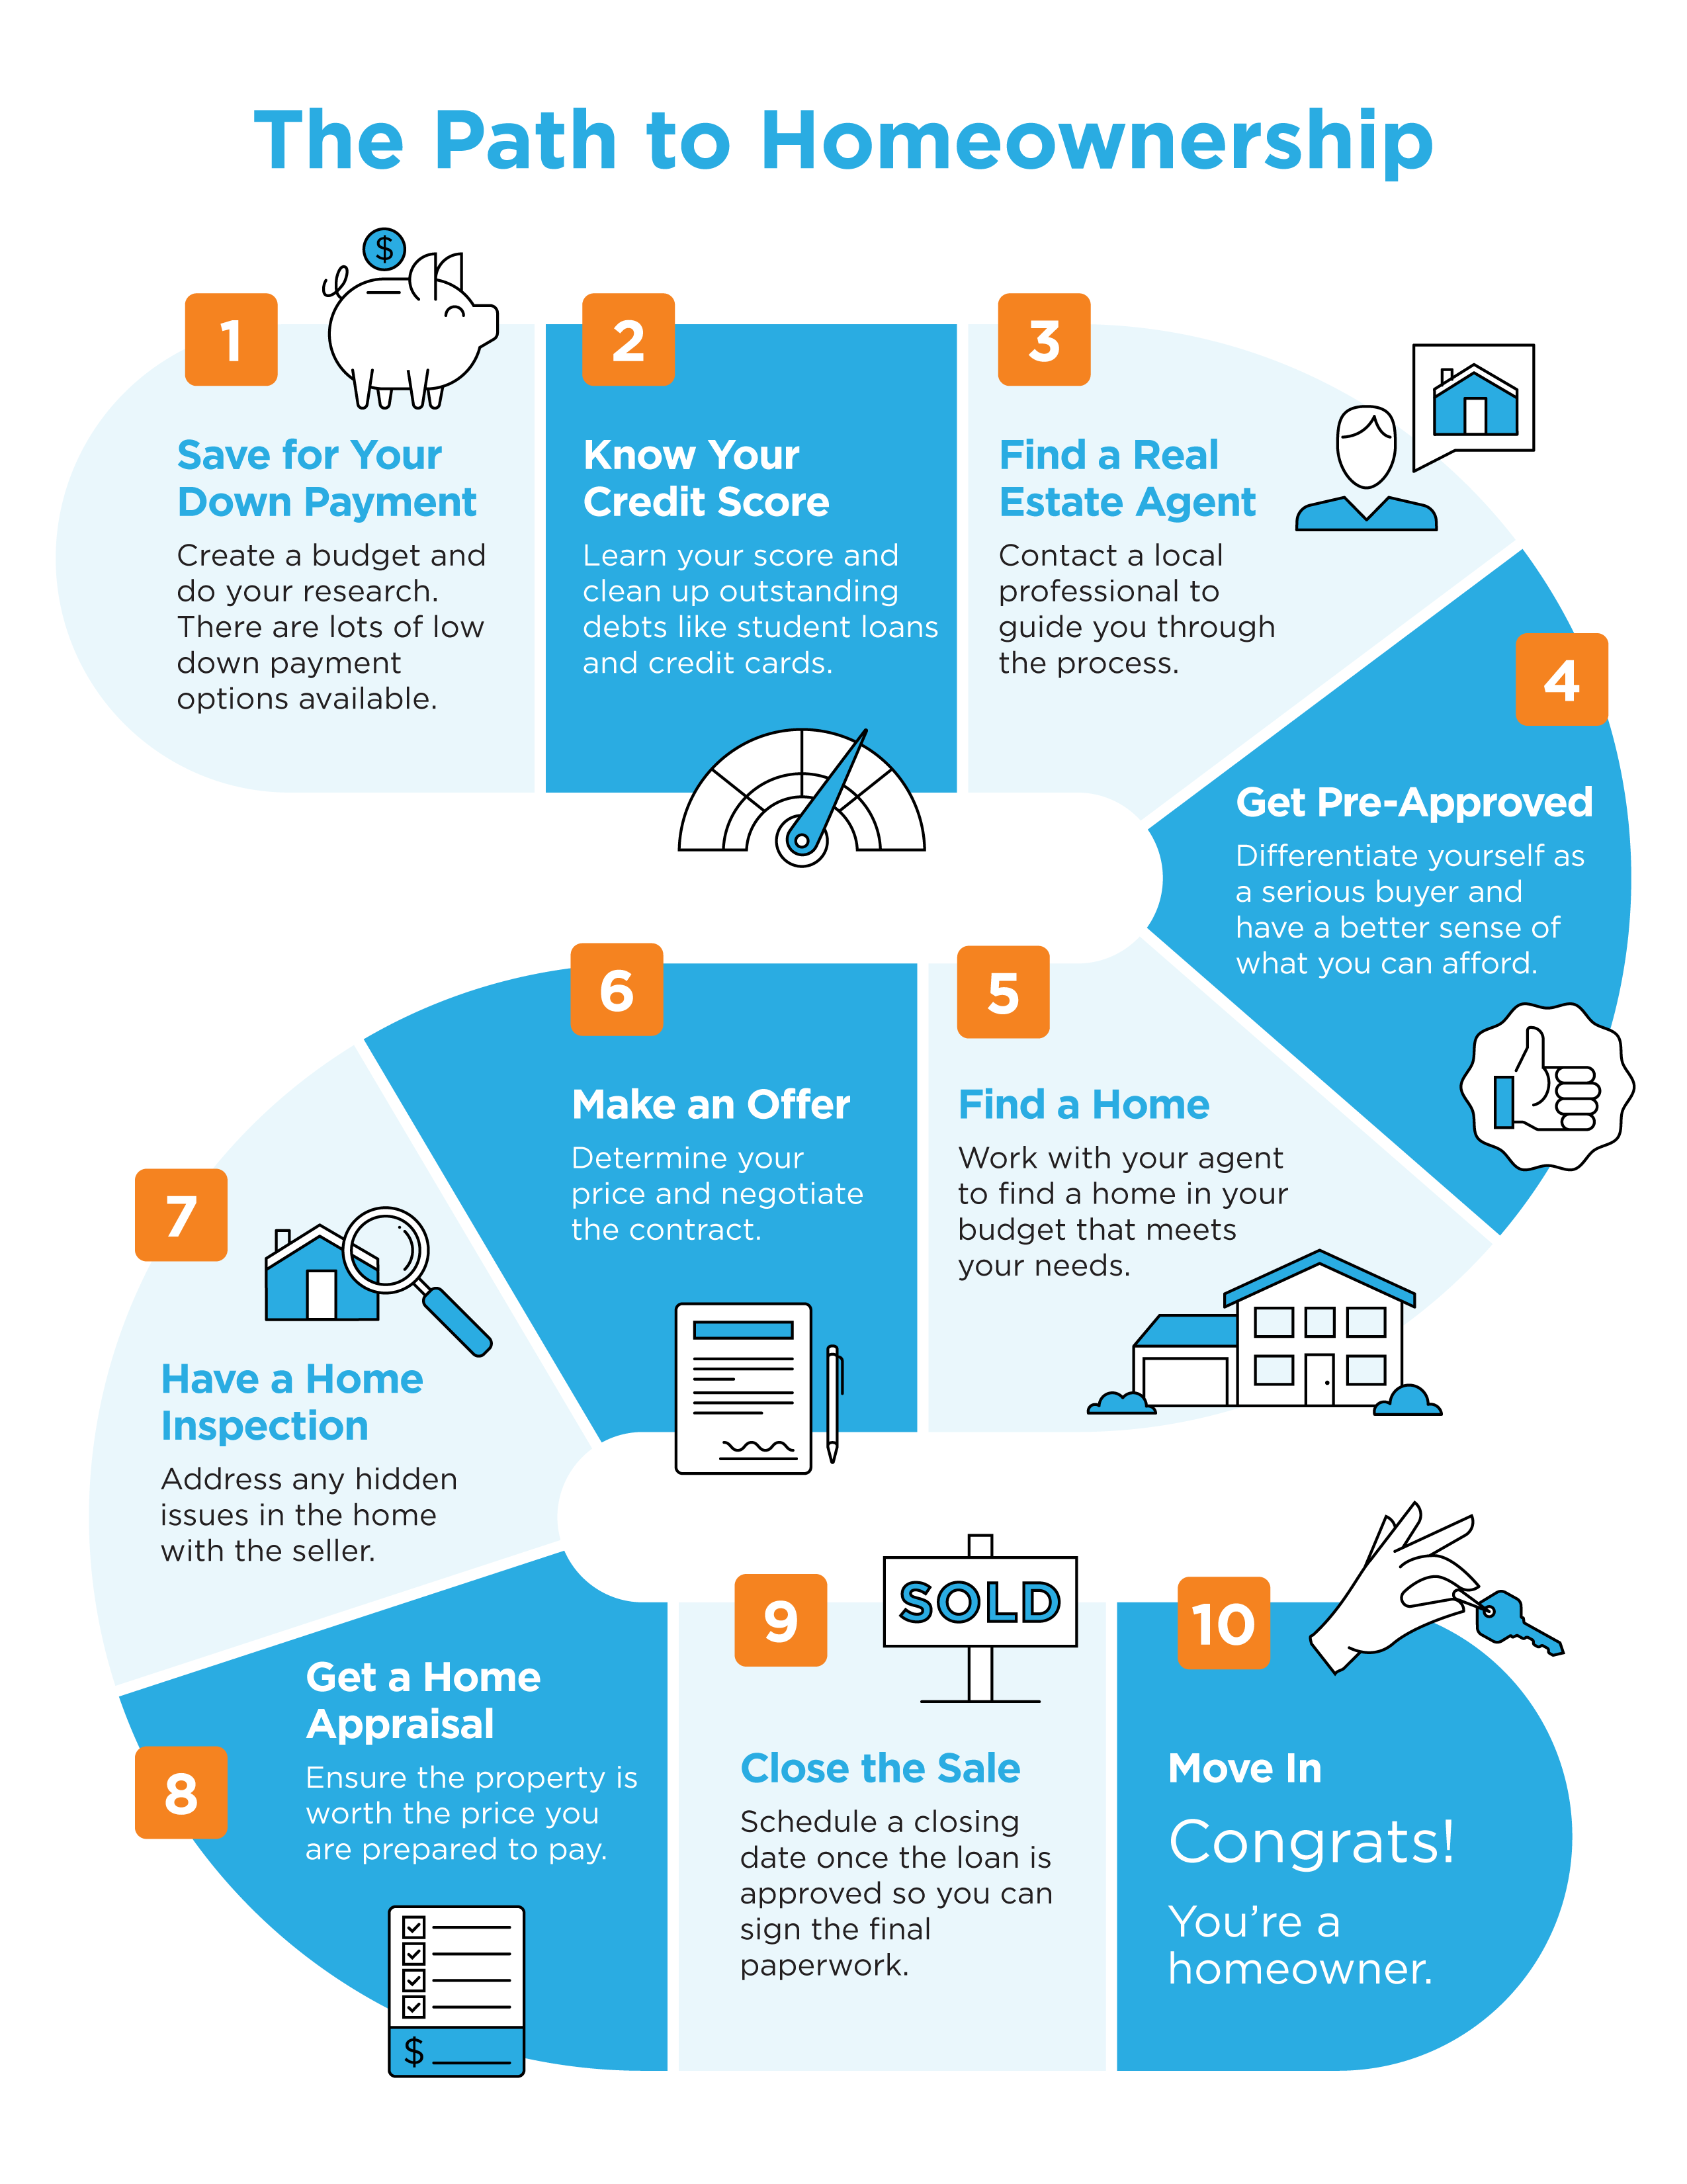
13

Slide 14
Do I Really Need a 20% Down Payment?
Is the idea of saving for a down payment holding you back from buying a home right now? You may be eager to take advantage of today’s low mortgage rates, but the thought of providing a large down payment might make you want to pump the brakes. Today, there’s still a common myth that you need to come up with 20% of the total sale price for your down payment. This means people who could buy a home may be putting their plans on hold because they don’t have that much in the bank yet. The reality is – whether it’s your first home or you’ve purchased one before – you most likely don’t need a 20% down payment. Here’s why.
According to Freddie Mac:
“The most damaging down payment myth—since it stops the homebuying process before it can start—is the belief that 20% is necessary.”
If saving that much money sounds daunting, potential homebuyers might give up on the dream of homeownership before they even begin – but they don’t have to.
The 2020 Profile of Home Buyers and Sellers from the National Association of Realtors (NAR) notes how the median down payment hasn’t been over 20% since 2005, and even then, that was only for repeat buyers, not first-time homebuyers.
14
Notes:
https://sf.freddiemac.com/articles/insights/down-payments-helping-future-borrowers-bridge-the-awareness-gap
https://www.nar.realtor/research-and-statistics/research-reports/highlights-from-the-profile-of-home-buyers-and-sellers

Slide 15
As the image below shows, today’s median down payment is clearly less than 20%.
What does this mean for potential homebuyers?
If you’re a first-time buyer and putting down 7% still seems high, understand that there are programs allowing qualified buyers to purchase a home with a down payment as low as 3.5%. There are even options like VA loans and USDA loans with no down payment requirements for qualified applicants.
It’s important for potential homebuyers to know they likely don’t need a 20% down payment, but they do need to do their homework to understand the options available. When you’re interested in learning more about down payment assistance programs, information is available through sites like downpaymentresource.com. Be sure to also work with trusted professionals from the start to learn what you may qualify for in the homebuying process.
Bottom Line
Don’t let down payment myths keep you from hitting your homeownership goals. If you’re hoping to buy a home this year, let’s connect to review your options.
Today’s Median Down Payment Is Less Than 20%
Common Misconception: 20%
NAR
15
Notes:
https://www.nar.realtor/research-and-statistics/research-reports/highlights-from-the-profile-of-home-buyers-and-sellers
https://www.hud.gov/buying/loans
https://www.benefits.va.gov/homeloans/index.asp
https://www.rd.usda.gov/newsroom/news-release/usda-rural-home-loans-offer-100-financing-and-no-down-payment
https://downpaymentresource.com/

Slide 16
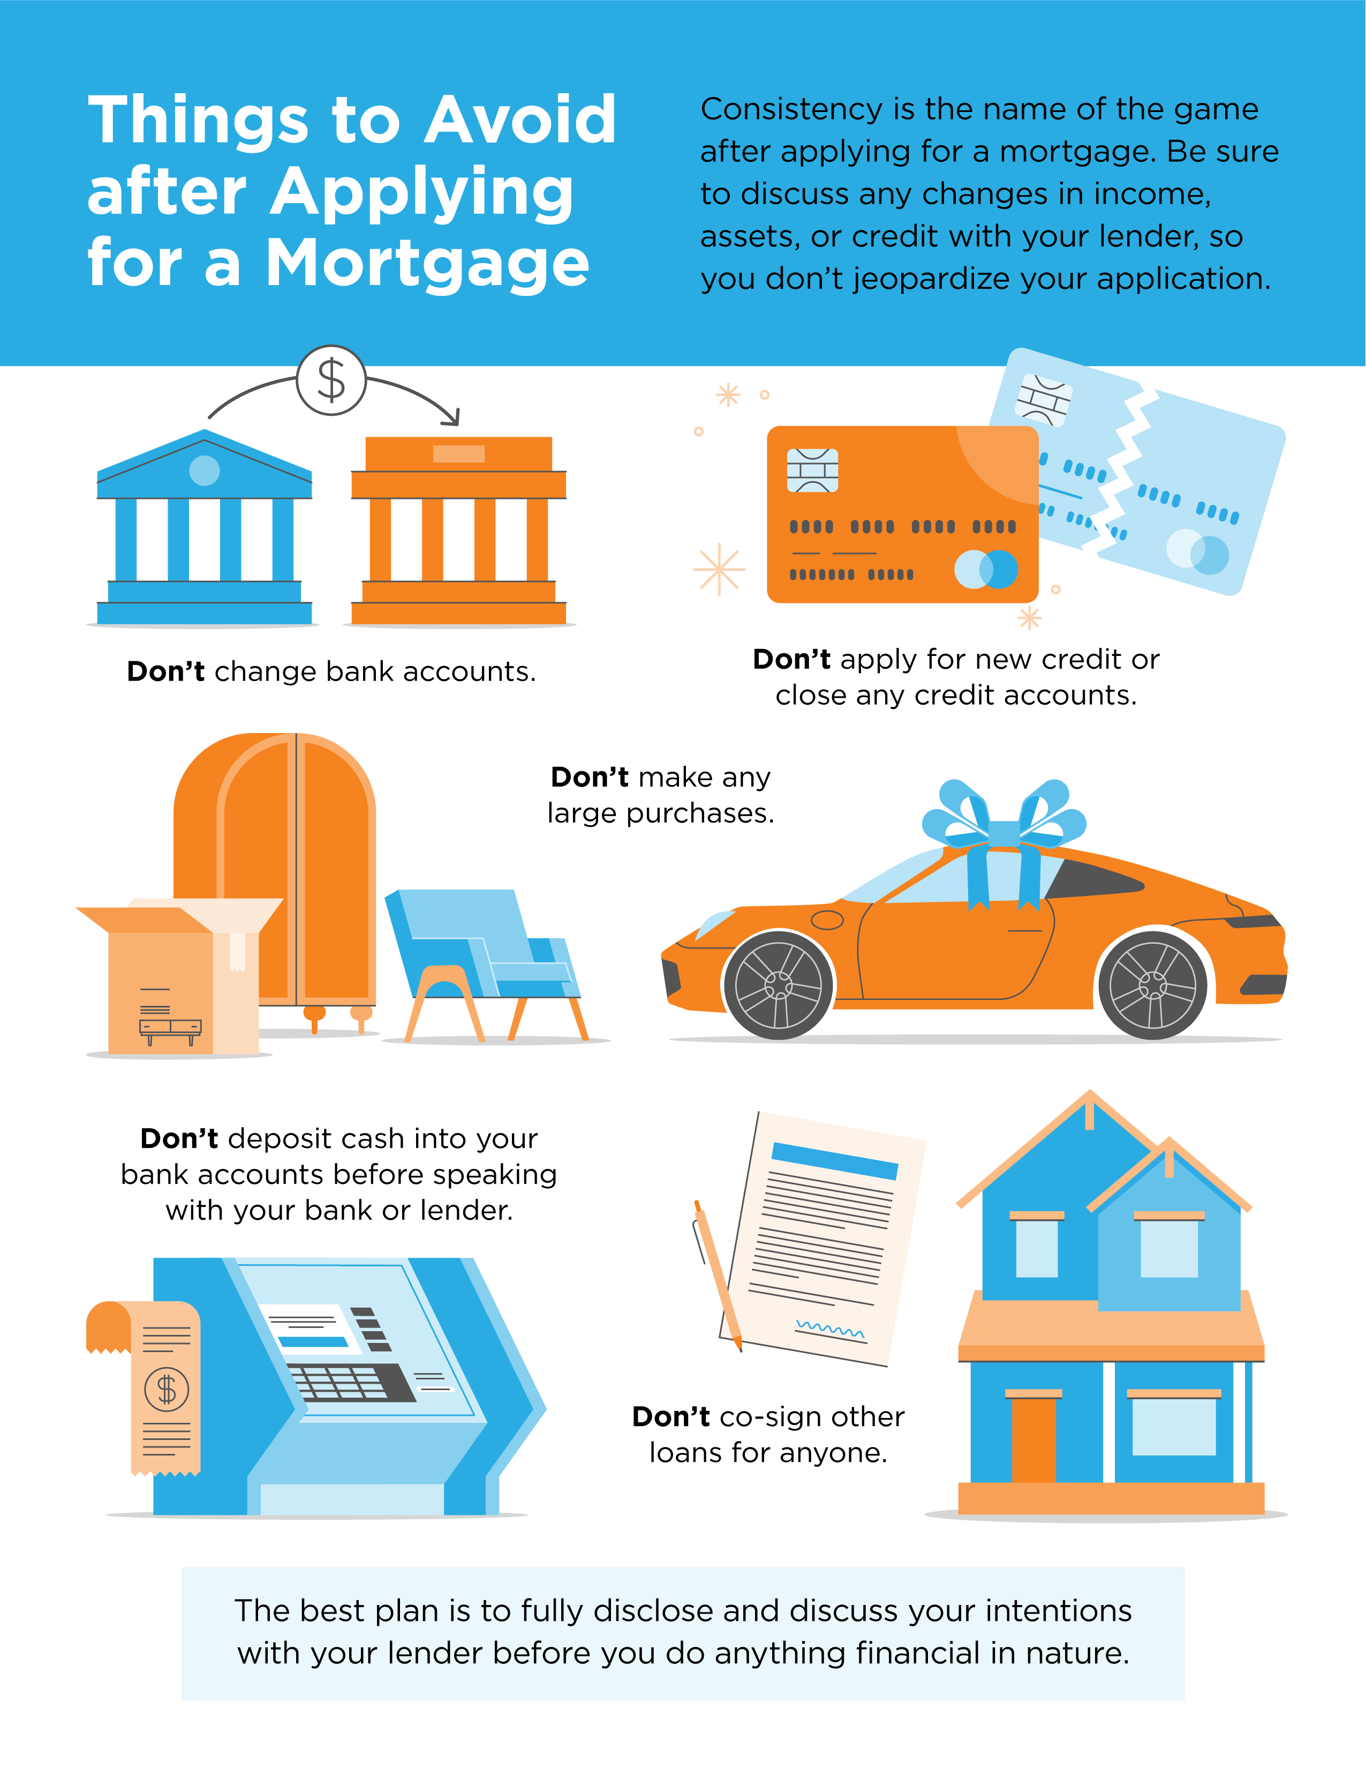
16

Slide 17
5 Tips for Making a Successful Offer
Today’s real estate market clearly has high homebuyer interest and low housing inventory. With so many buyers competing for a limited number of houses for sale, it’s more important than ever to know the ins and outs of making a confident and competitive offer. Here are five keys to success for this important stage in the homebuying process.
1. Listen to Your Real Estate Advisor
An article from Freddie Mac offers guidance on making an offer on a home today. Right off the bat, it points out how emotional this can be for buyers and why your trusted agent can help you stay focused on the most important things:
“Remember to let your homebuying team guide you on your journey, not your emotions. Their support and expertise will keep you from compromising on your must-haves and future financial stability.”
Your real estate professional should be your primary source for answers to the questions you have when you’re ready to make an offer.
2. Understand Your Finances
Having a complete understanding of your budget and how much house you can afford is essential. The best way to know this is to get pre-approved for a loan early in the homebuying process. Only 44% of today’s prospective homebuyers are planning to apply for pre-approval, so be sure to take this step so you stand out from the crowd. It shows sellers you’re a serious and qualified buyer and can give you a competitive edge if you enter a bidding war.
17
Notes:
http://www.freddiemac.com/blog/homeownership/20201019_5_rules_for_making_an_offer_on_a_home.page

Slide 18
3. Be Ready to Move Quickly
According to the Realtors Confidence Index, published monthly by the National Association of Realtors (NAR), the average property sale today receives over three offers and is on the market for just a few weeks. These are both results of today’s competitive market, showing how important it is to stay agile and vigilant in your search. As soon as you find the right home for your needs, be prepared to submit an offer as quickly as possible.
4. Make a Fair Offer
It’s only natural to want the best deal you can get on a home. However, Freddie Mac also warns that submitting an offer that’s too low can lead sellers to doubt how serious you are as a buyer. Don’t submit an offer that will be tossed out as soon as it’s received. The expertise your agent brings to this part of the process will help you stay competitive:
“Your agent will work with you to make an informed offer based on the market value of the home, the condition of the home and recent home sale prices in the area.”
5. Be a Flexible Negotiator
After submitting an offer, the seller may accept it, reject it, or counter it with their own changes. In a competitive market, it’s important to stay nimble throughout the negotiation process. You can strengthen your position with an offer that includes flexible move-in dates, a higher price, or minimal contingencies (conditions you set that the seller must meet for the purchase to be finalized). Freddie Mac explains that there are, however, certain contingencies you don’t want to forego:
“Resist the temptation to waive the inspection contingency, especially in a hot market or if the home is being sold ‘as-is’, which means the seller won’t pay for repairs. Without an inspection contingency, you could be stuck with a contract on a house you can’t afford to fix.”
Bottom Line
Today’s competitive landscape makes it more important than ever to make a strong offer on a home. Let’s connect to make sure you rise to the top along the way.
18
Notes:
https://www.nar.realtor/research-and-statistics/research-reports/realtors-confidence-index
http://www.freddiemac.com/blog/homeownership/20201019_5_rules_for_making_an_offer_on_a_home.page

Slide 19
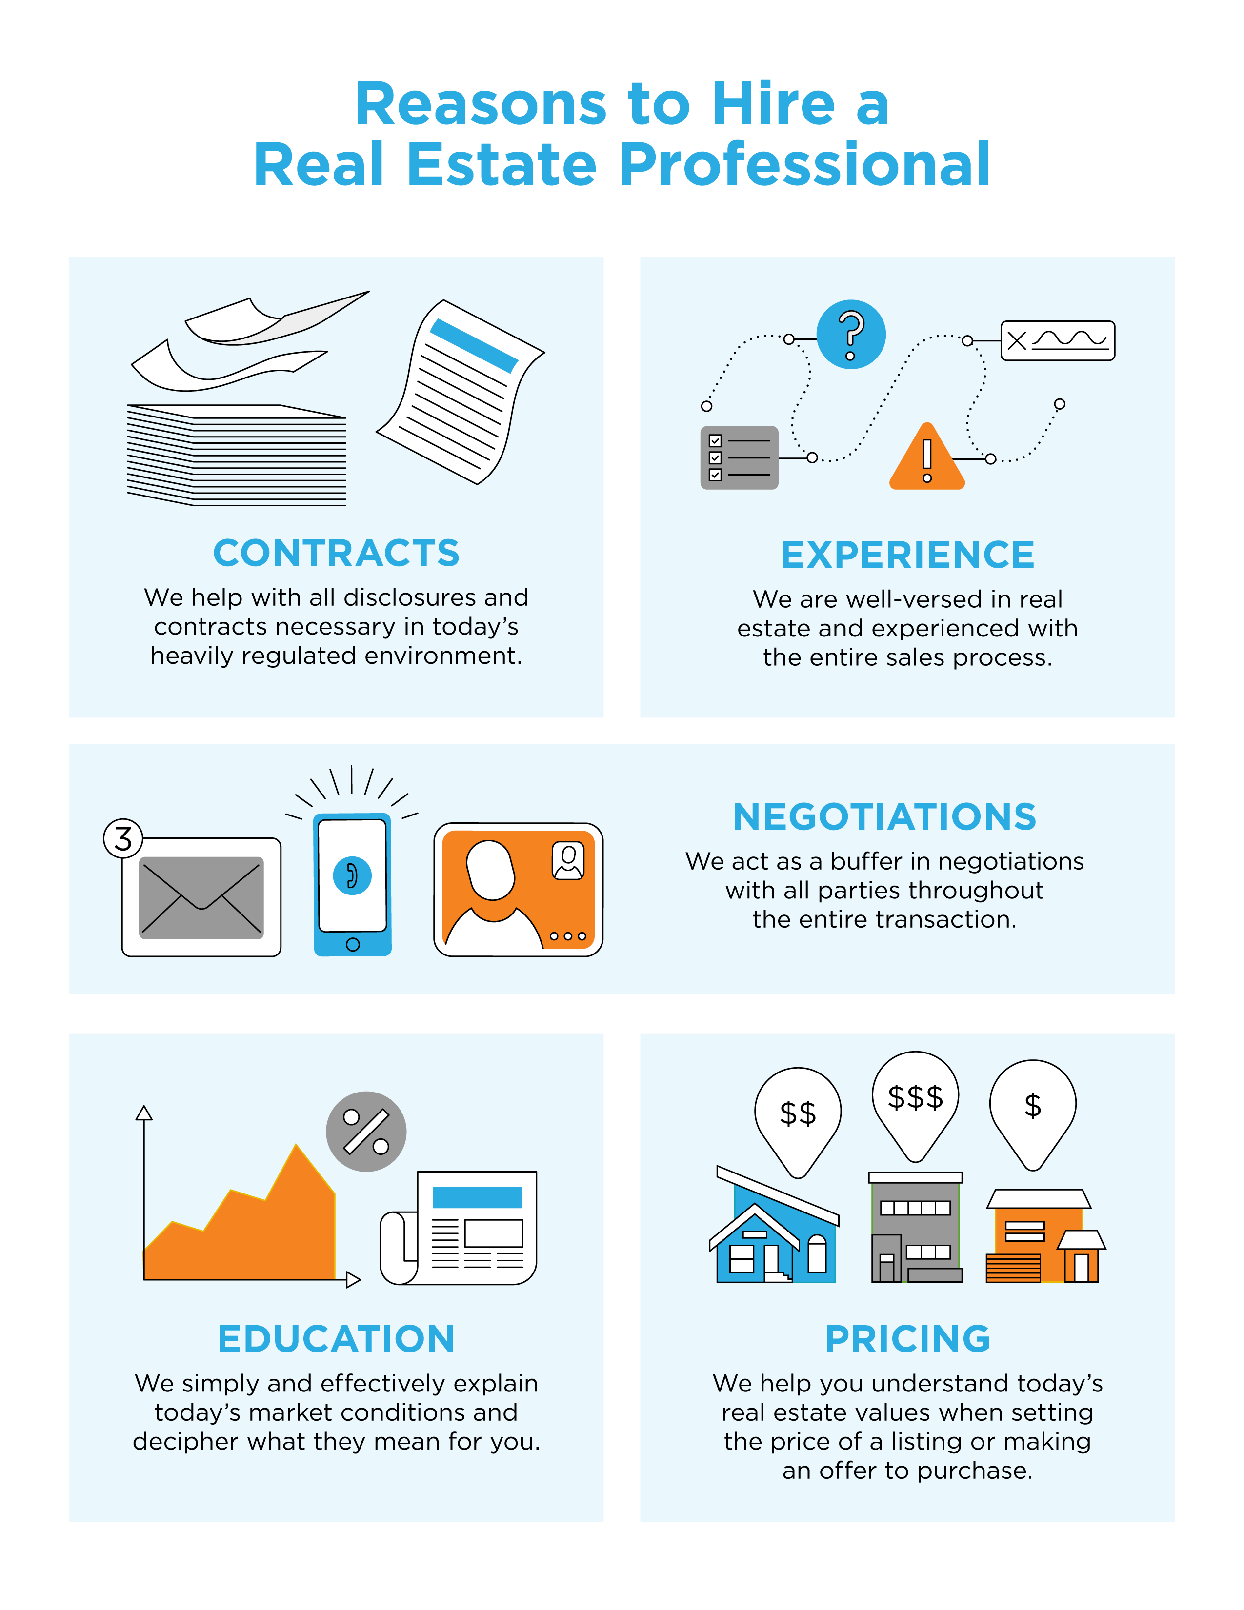
19

Slide 20
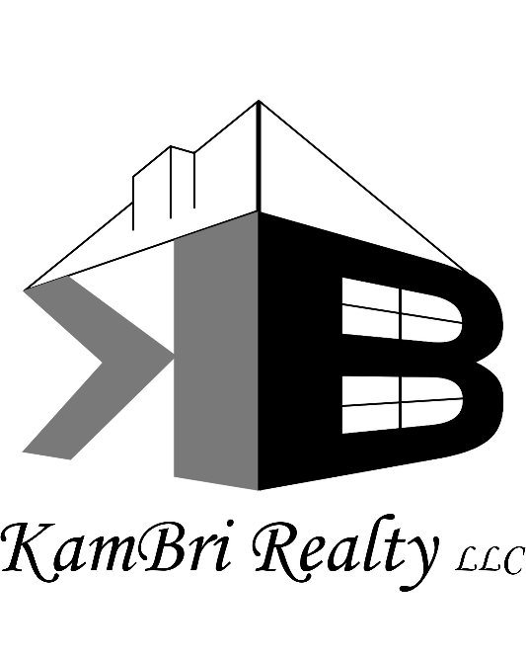
CONTACT ME TO TALK MORE
I’m sure you have questions and concerns about the real estate process.
I’d love to talk with you about what you read here and help you on the path to buying your new home. My contact information is below, and I look forward to working with you.
KARYN MURPHY
Owner/Managing Broker
KamBri Realty, LLC
Mokena, IL KarynMurphyKBR.com
(708)278-6996
Equal Housing Opportunity

